Slide 1
The Seven Deadly Sins of PowerShell
Fred
Notes:
[REQUIRED SLIDE]

Slide 2
Notes:
[REQUIRED SLIDE]

Slide 3
Agenda
7 Bad coding practices that add technical debt
What are they?
Why is it bad?
Why do we do it?
What to do instead?

Slide 4
7th Sin
Forcing interactive mode

Slide 5
6th Sin
Hardcoding Data

Slide 6
5th Sin
The One Long Script

Slide 7
4th Sin
Breaking Bad

Slide 8
3rd Sin
Confusing Message with Output

Slide 9
2nd Sin
Violating the Scope Boundary

Slide 10
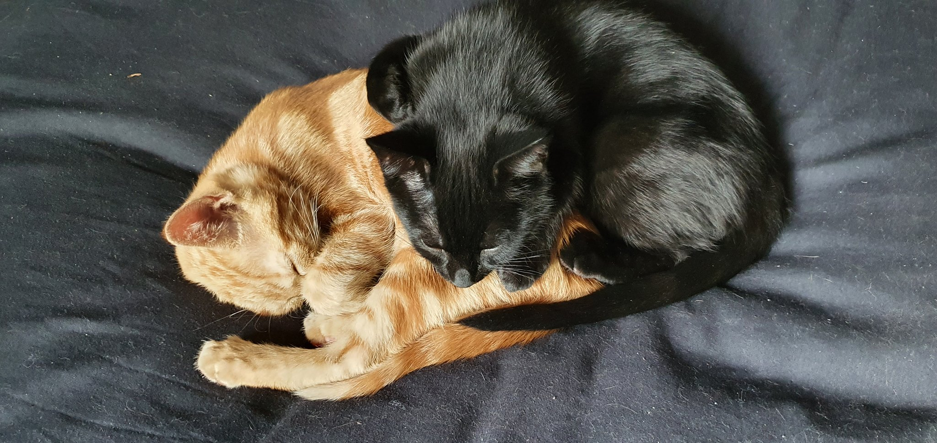

Slide 11
1st Sin
Dynamic Parameters for
Dynamic Tab Completion

Slide 12
Summary
Most issues are born out of:
Ignorance
Lack of tooling
Convenience
Executing Code from Editor*
… and then perpetuated through copy&pasta

Slide 13
Notes:
[REQUIRED SLIDE]

Slide 14

about_Speaker
Name: Fred / Friedrich Weinmann
Premier Field Engineer (Security & Automation)
Interests: PowerShell, Reading, Bartending
Projects:
https://psframework.org
https://admf.one
Github: https://github.com/Friedrichweinmann
Twitter: @FredWeinmann
Slack: Fred (http://slack.poshcode.org/)
Notes:
[REQUIRED SLIDE]

Slide 15

Delegate sign-up opens November 2020 at https://psconf.eu
Notes:
[REQUIRED SLIDE]

